Slide 1
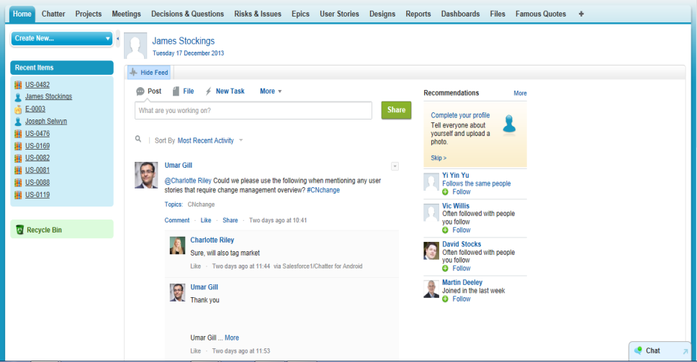
Deloitte’s Tracker – Get involved!
This practical guide is designed to help you navigate and get everything you want out of the Tracker project management tool. It is designed to be compact so you can always carry it with you!
Tracker both helps you to track project management issues (as highlighted in yellow) as well as follow your user stories through the sprint development lifecycle (as highlighted in blue)
Top Tip
To stay up to date with tips and tricks join the “Tracker Tips and Tricks” Chatter Group
The Chatter page with your feed, profile and groups
Risks and issues as raised during the project
For viewing epic details and status
Selection of reports and charts (dashboards)
Your homepage, with chatter, dashboards and tasks
Meetings log with notes, attendees, linked decision, issues, and risks.
Database of Key decisions or questions arising during the project
For tracking user stories and their progress through sprints
+ - All tabs currently not visible on your home screen are available here. To customise which tabs to display on your home screen, select “+” and “Customise Tabs”
When you log in...
...to Tracker, you will land on the Tab. On your Home Tab you can see a summary of the Chatter Feed.
The Homepage is split as follows:
List of Tabs for navigation
Chatter feed with updates from what you “follow”
Recommended users, groups of files to follow
Sidebar – collapsible with recent items (visible from all tabs)
1
4
3
2
5
Chat – allows you to chat directly to other online users: (visible from all tabs)
Top Tip
Welcome to Tracker: Your To-Do List
In your inbox (please check your spam folder), find the email from support@salesforce.com and click in on the “Log in automatically” link to log in for the first time and set your user-name and password. For future logins, navigate to http://login.salesforce.com
Click on your name on the “Home”-Tab, and upload a picture to your Chatter profile (by clicking on the grey outline of a portrait). Also complete the “Contact” and “About You” sections by clicking the pencil icon below your profile picture.
Select the “Chatter” Tab, then “People” or “Groups” (left menu): navigate through the people or groups and start “following” what you are interested in. (more about Chatter on page 2)
Review user stories in your area through “User Stories” Tab: Select the “All User Stories” list and hit “Go!”. You will now be able to see all user stories is a filterable list, and can review these in detail by clicking on the underlined name: e.g. “US-001”. Follow a user story to stay up to date
To get immediate alerts on allow groups, people and items you follow, download the Salesforce1 app for iPhone or iPad in the App Store! Or get the desktop app:, select your name in the top right corner of the online application, select “Setup”. Then click on “Desktop Integration” on the left and “Chatter Desktop”

Slide 2
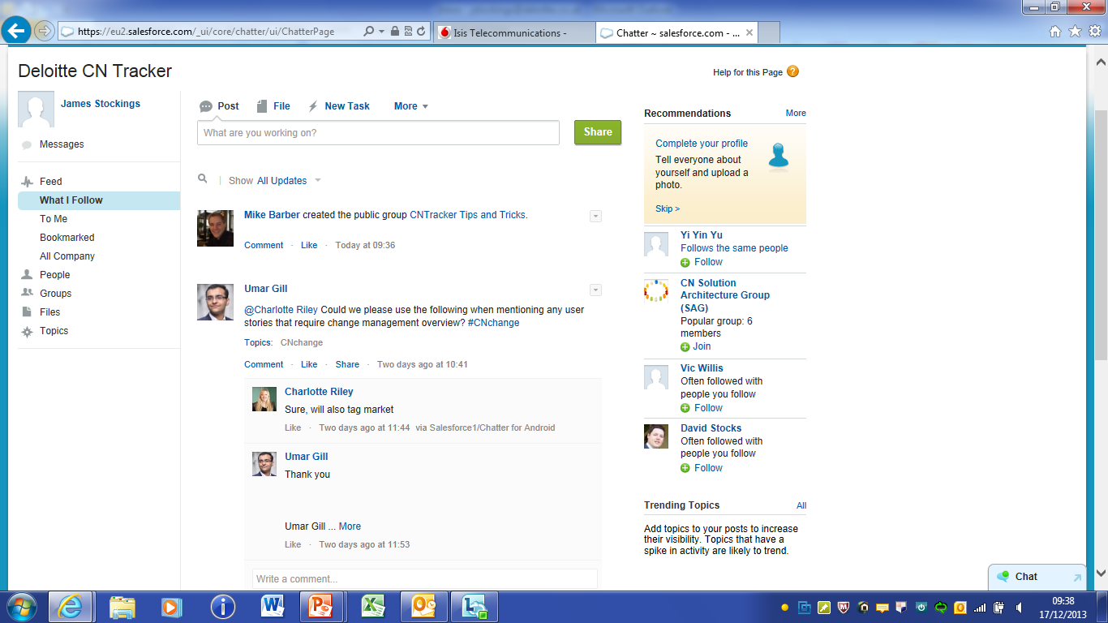
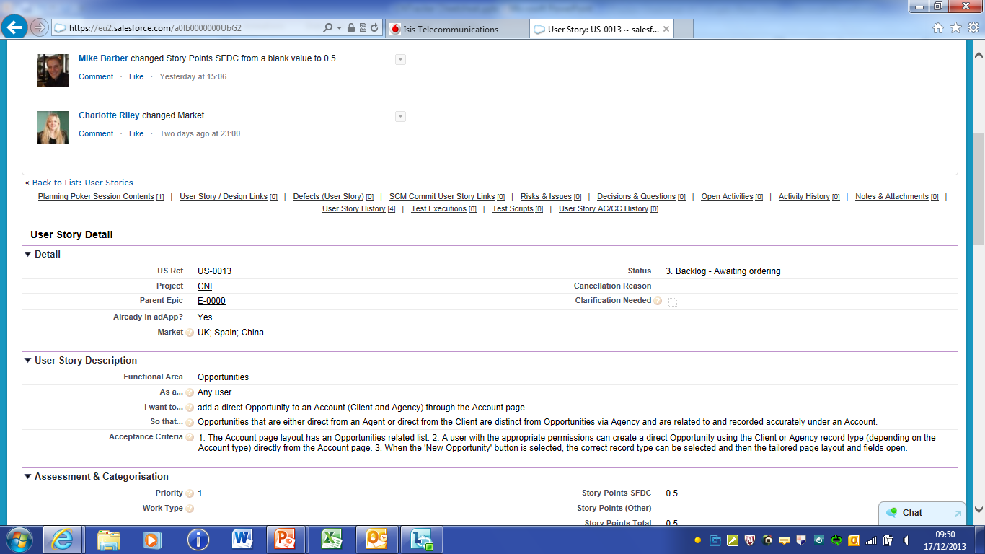

Chatter is Tracker’s collaboration tool, designed to improve the transparency and communication throughout the project
Post: just share a comment
Share a File: share a document
Share a Link
Your Chatter feed contains all post including yours. Scroll down to see previous posts. To see all posts from other areas of the organisation, change from Updates to “My Chatter” to Updates from “People”, “Groups” or items
Review your recommendat-ions and join additional groups/ follow additional content to stay up-to-date
The menu on the left allows you to:
Upload your picture
View posts you’re tagged in (@)
View your bookmarks
View people, groups or files your follow
Review trending topics (#)
Top Tip
Using Chatter – Making the most out of collaboration!
User-Tagging: use the @ symbol to “tag” a colleague in any post. E.g. start to type @Jo... Then select “Jon Lester” from the drop down that automatically appears to tag. This means the post will appear at the top of the tagged users chatter feed, and they will be emailed!
Hash-Tagging (topics): similar to Twitter, you can add a # prior to a word to tag this word for future searches
Following: select the “Follow” link at the top of a person, group or items to receive all their related chatter posts directly on your homepage feed
Bookmarking: If you find an interesting post you want to be able to find easily later, then bookmark that post by click on the symbol in the top right corner. You can then find it again under Chatter>Bookmarks
User Stories are the business foundation of the iterative agile development lifecycle. Unlike use cases, user stories are short, snappy and open to interpretation where acceptance criteria is used for clarification, design direction, testing and completion, and user sign off.
User Story Format
As a ... I want to... So that...
Acceptance Criteria Format
Given a .. <context>... And ... <added info> ... When ... <event>... Then... <outcome> ... And ... <added outcome>.
Can also take bullet-point form of field-lists etc.
User Story information
Acceptance Criteria
In Tracker, User Stories can be found in the tab. Please review the user stories and provide comments and feedback via Chatter! Your input is invaluable to the process
Top Tip
Global Search
Tracker allows you to run a search through ALL data (including chatter posts, user stories, groups,..) through the search at the top of screen. Just type in your comment and filter the results by category.

